Slide 1
Fundamentals of Corporate Finance
by
Robert Parrino, Ph.D. & David S. Kidwell, Ph.D.

Slide 2
CHAPTER 8
Bond Valuation and the Structure
of Interest Rates

Slide 3
Corporate Bonds
Quick Links
Capital Market Efficiency
Bond Valuation
Bond Yields
Interest Rate Risks
The Structure of Interest Rates

Slide 4
Capital Market Efficiency
Supply and demand for securities are better reflected in organized markets.
Any price balancing overall supply and demand for a security is market equilibrium price.
A security’s true value is price reflecting investors’ estimates of value of expected future cash flows.
In efficient capital market, security prices fully reflect knowledge and expectations of all investors at particular point in time.

Slide 5
Capital Market Efficiency
If markets are efficient, investors and financial managers can believe securities are priced at or near true value.
The more efficient a security market, the more likely securities are priced at or near true value.
Overall efficiency of a capital market depends on its operational and informational efficiency.
Operational efficiency focuses on bringing buyers and sellers together at lowest possible cost.

Slide 6
Capital Market Efficiency
Markets exhibit informational efficiency if market prices reflect all relevant information about securities at particular point in time.
In an informationally efficient market, market prices adjust quickly to new information about a security as it becomes available.
Competition among investors is important driver of informational efficiency.

Slide 7
Capital Market Efficiency
Efficient Market Hypotheses
Prices of securities adjust as investors buying and selling lead to prices truly reflecting market’s consensus – reflecting market’s efficiency.
Market efficiency can be explained at three form levels:
  1) strong
  2) semi-strong
  3) weak

Slide 8
Capital Market Efficiency
Strong form market efficiency
  Strong form states price of security in market reflects all information – public as well as private, insider information.

Slide 9
Capital Market Efficiency
Semi-strong market efficiency
  Implies that only public information available to all investors is reflected in security’s market price.
  Investors with access to insider or private information will be able to earn abnormal returns.

Slide 10
Capital Market Efficiency
Semi-strong market efficiency
  Public stock markets in developed countries like U.S. have semi-strong form of market efficiency.
  New information is immediately reflected in security’s market price.

Slide 11
Capital Market Efficiency
Weak-form market efficiency
  All information contained in security’s past prices is reflected in current prices.
  It would not be possible to earn abnormally high returns by looking for patterns in security prices, but it would be possible to do so by trading on public or private information.

Slide 12
Corporate Bonds
Market for Corporate Bonds
  Largest investors in corporate bonds are life insurance companies and pension funds.
    Trades in this market tend to be in very large
    blocks of securities.
  Less than 1% of all corporate bonds are traded on exchanges.
    Most secondary market corporate bond transactions take place through dealers in the over-the-counter (OTC) market.

Slide 13
Corporate Bonds
Market for Corporate Bonds
  At end of 2007, for example, amount of corporate and foreign debt outstanding was $10.1 trillion, making it the second largest segment of the U.S capital market.
  The largest market was the market for corporate equity with value of $20.8 trillion, followed by state and local government bond market valued at $2.1 trillion.

Slide 14
Corporate Bonds
Market for Corporate Bonds
  Only a small number of existing total bonds actually trade on single day.
    Result: corporate bond market is thin compared to market for money market securities or corporate stocks.
  Corporate bonds are less marketable than securities with higher daily trading volumes.
  Prices in corporate bond market also tend to be more volatile than that of securities sold in market with greater trading volumes.

Slide 15
Corporate Bonds
Bond Price Information
  Corporate bond market is not considered very transparent; it trades predominantly OTC, difficult for investors to view prices, trading volume.
  Also, many corporate bond transactions are negotiated between buyer and seller; there is little centralized reporting of these deals.

Slide 16
Corporate Bonds
Types of Corporate Bonds
Corporate bonds are long-term IOUs that represent claims against a firm’s assets.
Debt instruments where the interest income paid to investors is fixed for the life of the contract are called fixed-income securities.
Three types of corporate bonds are – vanilla bonds, zero coupon bonds, and convertible bonds.

Slide 17
Vanilla Bonds
Types of Corporate Bonds
Vanilla bonds have coupon payments fixed for life of bond, and at maturity, principal is paid and bonds are retired.
Vanilla bonds have no special provisions; provisions they do have are conventional and common to most bonds, e.g., a call provision.
Payments usually made annually or semiannually.

Slide 18
Vanilla Bonds
Types of Corporate Bonds
  Face value, or par value, for most corporate bonds is $1,000.
  Bond’s coupon rate is calculated as annual coupon payment (C) divided by bond’s face value (F).

Slide 19
Zero Coupon Bonds
Types of Corporate Bonds
Corporations sometimes issue bonds with no coupon payments, only offering one payment at maturity.
Zero coupon bonds sell well below their face value (at deep discount) because they offer no coupons.
U.S. Treasury is most frequent and regular issuer of zero coupon securities.

Slide 20
Convertible Bonds
Types of Corporate Bonds
Convertible bonds are bonds that can be converted into shares of common stock at pre-determined ratio at discretion of bondholder.
Convertibility feature allows bondholders to share firm’s good fortunes if the firm’s stock rises above certain level.

Slide 21
Convertible Bonds
Types of Corporate Bonds
Conversion ratio is set so firm’s stock price must appreciate 15%-20% before it is profitable to convert bonds into equity.
To secure this advantage, bondholders are willing to pay a premium.

Slide 22
Bond Valuation
The value, or price, of any asset is present value of its future cash flows.
To calculate bond’s price, follow same process as to value any financial asset.
  Estimate expected future cash flows – these are the coupons that the bond will pay.

Slide 23
Bond Valuation
Determine bond’s required rate of return, or discount rate.
  This is the market interest rate, called bond’s yield to maturity (or more commonly, yield).
Compute current value, or price, of a bond (PB) by calculating the present value of bond’s expected cash flows:
  PB = PV (Coupon payments)+ PV (Principal payments)

Slide 24
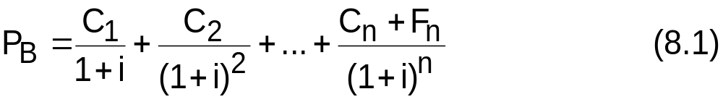
Bond Valuation
The general equation for the price of a bond can be written as follows:

Slide 25
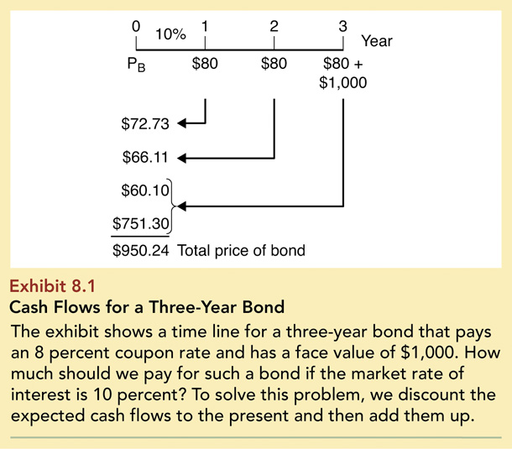
Exhibit 8.1: Cash Flows for a Three-Year Bond

Slide 26
Bond Valuation
Bond Valuation Example – Calculator solution
We can find the price of a bond with a financial calculator as follows:
Enter
3
10
80
1,000
N
i
PV
PMT
FV
Answer
-950.26

Slide 27
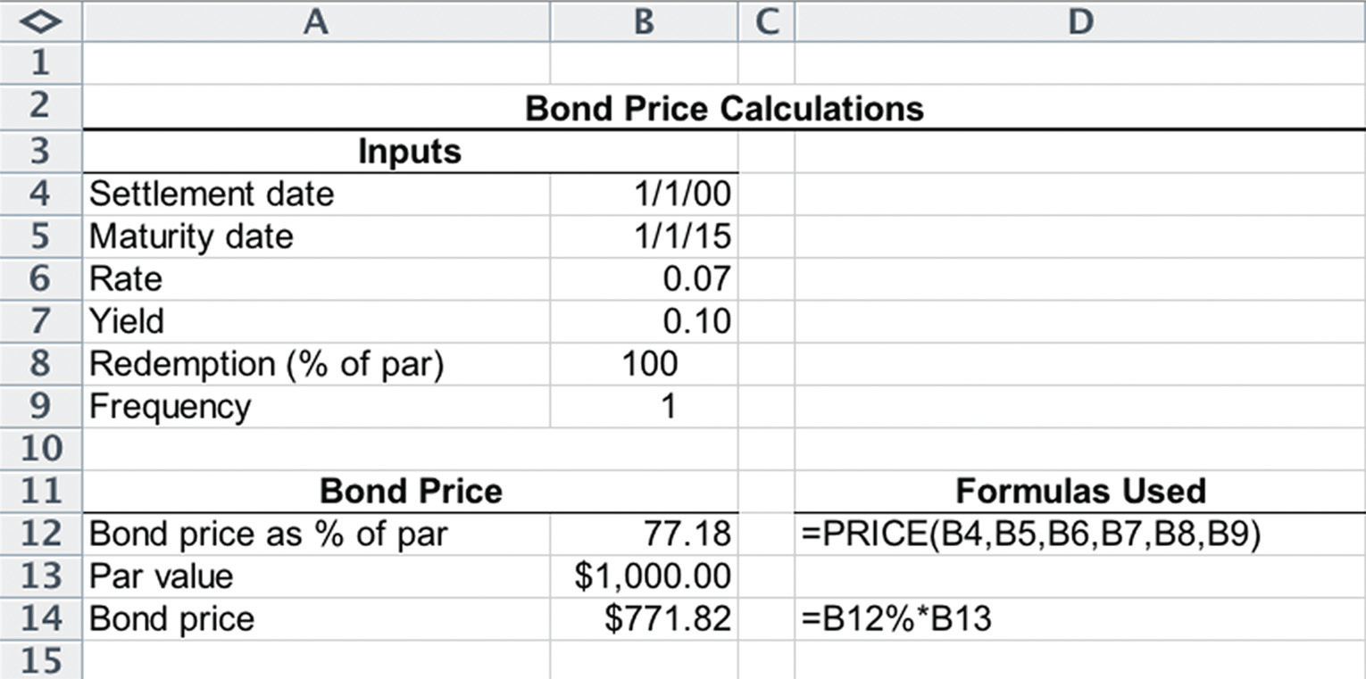
Using Excel - Bond Prices

Slide 28
Bond Valuation
Par, Premium, and Discount Bonds
If a bond’s coupon rate is equal to market rate, bond will sell at price equal to its face value; these are called par bonds.
If a bond’s coupon rate is less than market rate, then bond will sell at price less than its face value; these are called discount bonds.
If a bond’s coupon rate is greater than market rate, then bond will sell at price more than its face value; these are called premium bonds.

Slide 29
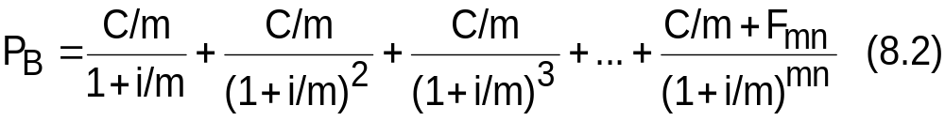
Bond Valuation
Semiannual Compounding
While bonds in Europe pay annual coupons, U.S. bonds pay coupons semi-annually.
Eq. 8.2 shows how to value bonds paying semi-annual coupons.

Slide 30
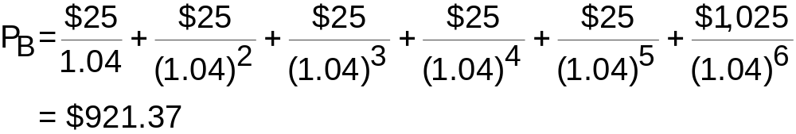
Bond Valuation
Semiannual Compounding Example
What is the price of a three-year, 5 percent coupon bond when the market interest rate is 8 percent, if the coupon payments are made semi-annually?
Semi-annual market yield = 8%/2 = 4%
Semi-annual coupon payment = $50/2 = $25

Slide 31
Bond Valuation
Semiannual Compounding Example- Calculator Solution
Enter
6
4
25
1,000
N
i
PV
PMT
FV
Answer
-921.37

Slide 32
Bond Valuation
Zero Coupon Bonds
Zero coupon bonds have no coupon payments but promise a single payment at maturity.
The price (or yield) of a zero coupon bond is simply a special case of Equation 8.2, where all coupon payments are equal to zero.

Slide 33
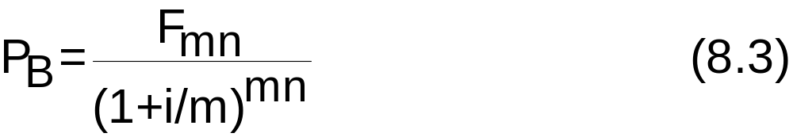
Bond Valuation
Zero Coupon Bonds
Hence, the pricing equation for zero coupon bonds is:
Zero coupon bonds, for which all cash payments are made at maturity, must sell for less than similar bonds that make periodic coupon payments.

Slide 34
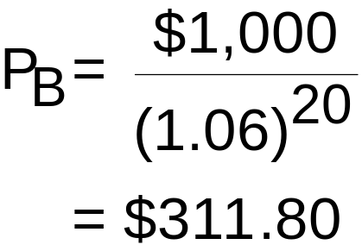
Bond Valuation
Zero Coupon Bond Price Example
What is the price of a zero coupon bond with a $1,000 face value, 10-year maturity, and semiannual compounding when the market interest rate is 12 percent?

Slide 35
Bond Yields
Yield to Maturity
A bond’s yield to maturity:
  Discount rate that makes present value of coupon and principal payments equal to price of bond.
It is the yield that investor earns if bond is held to maturity, and all coupon and principal payments are made as promised.
A bond’s yield to maturity changes daily as interest rates increase or decrease.

Slide 36
Bond Yields
Effective Annual Yield
On Wall Street, the EAR is called the effective annual yield (EAY) and EAR = EAY.
The correct way to annualize bond’s yield is:
EAY = (1 + Quoted rate/m)^{m} - 1
Simple annual yield is yield per period multiplied by number of compounding periods; for bonds with annual compounding, simple annual yield = semiannual yield × 2.

Slide 37
Bond Yields
Yield to Maturity and Effective Annual Yield Example
An investor buys a 30-year bond with a $1,000 face value for $800. The bond’s coupon rate is 8 percent and interest payments are made semi-annually. What is the bond’s yield to maturity and what is the effective annual yield?
Enter
60
-800
40
1,000
N
i
PV
PMT
FV
Answer
5.07

Slide 38
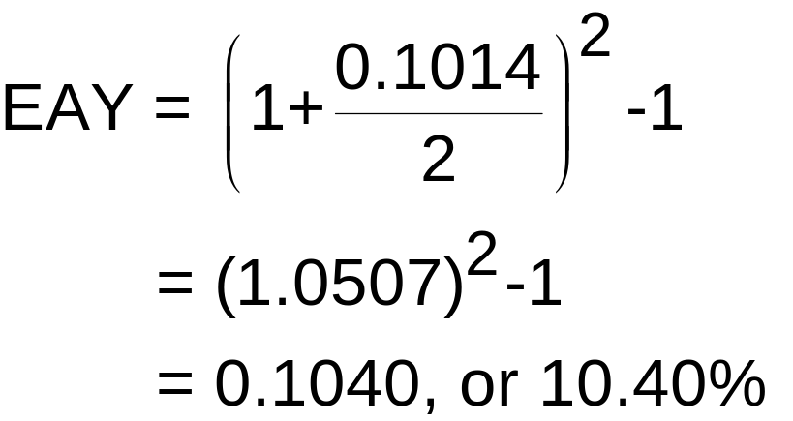
Bond Yields
Yield to Maturity and Effective Annual Yield Example

Slide 39
Bond Yields
Realized Yield
The return earned on a bond given the cash flows actually received by investor.
The interest rate at which the present value of actual cash flows generated by the investment equals bond’s price.
The realized yield is an important bond calculation, because it allows investors to see return they actually earned on their investment.

Slide 40
Interest Rate Risk
Bond Theorems
Bond prices are inversely related to interest rate movements.
  As interest rates decline, prices of bonds rise; as interest rates rise, prices of bonds decline.

Slide 41
Interest Rate Risk
Bond Theorems
For a given change in interest rates, prices of long-term bonds will change more than prices of short-term bonds.
Long-term bonds have greater price volatility than short-term bonds.
All other things being equal, long-term bonds are more risky than short-term bonds.
Interest rate risk increases as maturity increases, but at a decreasing rate.

Slide 42
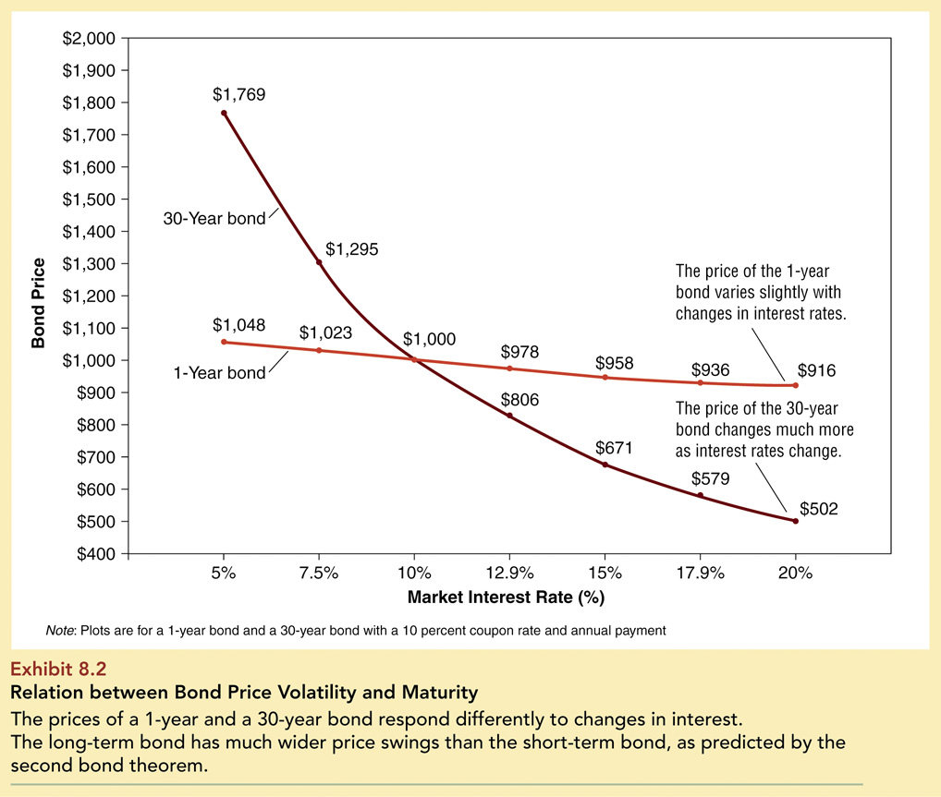
Exhibit 8.2: Relation Between Bond Price Volatility and Maturity

Slide 43
Interest Rate Risk
Bond Theorems
For a given change in interest rates, prices of lower-coupon bonds change more than prices of higher-coupon bonds.
The lower a bond’s coupon rate, the greater its price volatility; hence, lower coupon bonds have greater interest rate risk.

Slide 44
Interest Rate Risk
Bond Theorems
The lower the bond’s coupon rate, the greater the proportion of the bond’s cash flow investors will receive at maturity.
All other things being equal, a given change in the discount rate interest rates will have a greater impact on the price of a low-coupon bond than a higher-coupon bond with the same maturity.

Slide 45
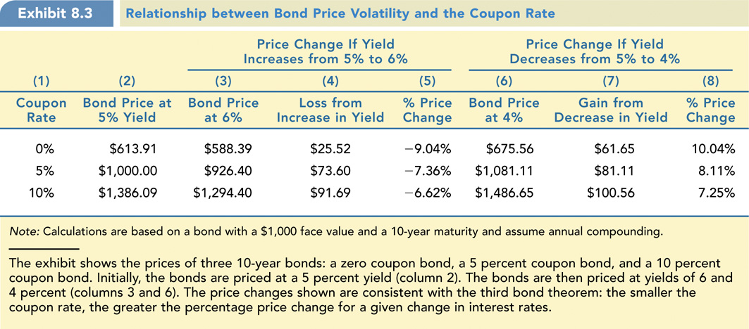
Exhibit 8.3: Relation between Bond Price Volatility and Coupon Rate

Slide 46
Interest Rate Risk
Bond Theorem Applications
If rates are expected to increase, portfolio manager should avoid investing in long term securities.
  Portfolio could see significant decline in value.
If you are an investor and you expect interest rates to decline, you may want to invest in long-term zero coupon bonds.
  As interest rates decline, price of long-term zero coupon bonds will increase more than any other type of bond.

Slide 47
The Structure of Interest Rates
Risk characteristics
Market analysts have identified four risk characteristics of debt instruments that are responsible for most of the differences in corporate borrowing costs:
  1. Security’s marketability
  2. Call feature
  3. Default risk
  4. Term to maturity

Slide 48
The Structure of Interest Rates
Marketability
Refers to investor’s ability to sell a security quickly at low transaction cost, and at its fair market value.
The lower these costs, the greater a security’s marketability.
The interest rate, or yield, on a security varies inversely with its degree of marketability.

Slide 49
The Structure of Interest Rates
Marketability
Difference in interest rates or yields between a marketable security (i_{high mkt}) and a less marketable security (i_{low mkt}) is the marketability risk premium (MRP):
MRP = i_{high mkt} - i_{low mkt} > 0
U.S. Treasury bills have the largest and most active secondary market.
  Are considered the most marketable of all securities.

Slide 50
The Structure of Interest Rates
Call Provision
Gives the firm issuing bonds option to purchase the bond from an investor at a predetermined price (the call price).
  Investors must sell the bond at that price
When bonds are called, investors suffer financial loss because they are forced to surrender their high-yielding bonds and reinvest their funds at lower prevailing market rate of interest.

Slide 51
The Structure of Interest Rates
Call Provision
Bonds with call provisions sell at higher market yields than comparable non-callable bonds.
Difference in interest rates between a callable bond and a comparable non-callable bond is the call interest premium (CIP); can be defined as follows:
CIP = i_{call} - i_{ncall} > 0
Bonds issued during periods when interest rates are high are likely to be called when interest rates decline; these bonds have a high CIP.

Slide 52
The Structure of Interest Rates
Default Risk
Risk that lender may not receive payments as promised.
Investors must be paid a premium to purchase security that exposes them to default risk.
Default risk premium (DRP) can thus be defined as follows:
DRP = i_{dr} - i_{rf}
No default risk in U.S. Treasury securities; best proxy measure for risk-free rate.

Slide 53
The Structure of Interest Rates
Bond Ratings
  Individuals and small businesses must rely on outside agencies for information on default potential of bonds.
  Two most prominent credit rating agencies: Moody’s Investors Service (Moody’s) and Standard & Poor’s (S&P).
    Both credit rating services rank bonds in order of expected probability of default; publish ratings as letter grades.

Slide 54
The Structure of Interest Rates
Bond Ratings
Highest grade bonds, those with lowest default risk, are rated Aaa (or AAA).
Investment grade bonds, in top four rating categories, are rated Aaa to Baa.
  State and federal laws typically require commercial banks, insurance companies, pension funds, other financial institutions, government agencies to purchase only investment-grade securities.

Slide 55
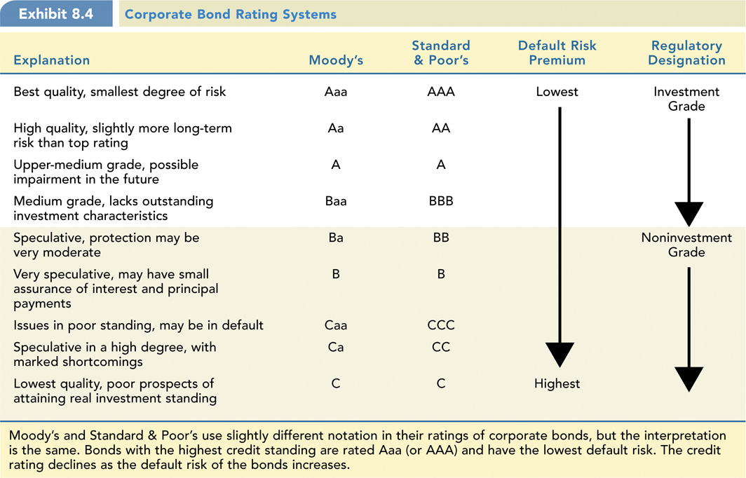
Exhibit 8.4: Corporate Bond Rating Systems

Slide 56
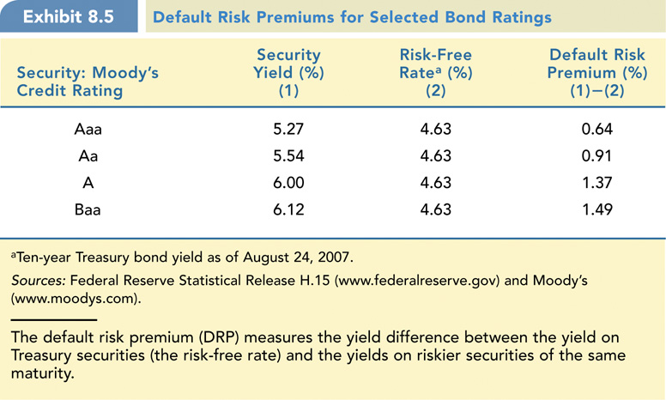
Exhibit 8.5: Default Risk Premiums

Slide 57
The Structure of Interest Rates
The Term Structure of Interest Rates
This is the relationship between yield and term to maturity.
Yield curves depict graphically how market yields vary as term to maturity changes.
Shape of yield curve is not constant over time.
As general level of interest rates rise and fall over time, yield curve shifts up and down and has different slopes.

Slide 58
The Structure of Interest Rates
Three basic shapes (slopes) of yield curves in the marketplace:
1. Ascending or normal yield curves are upward sloping yield curves that occur when economy is growing.
2. Descending or inverted yield curves are downward sloping yield curves that occur when economy is declining or heading into recession.
3. Flat yield curves imply interest rates unlikely to change in near future.

Slide 59
The Structure of Interest Rates
The Shape of the Yield Curve
Three economic factors determine shape of yield curve:
1) Real rate of interest
  2) Expected rate of inflation
3) Interest rate risk

Slide 60
The Structure of Interest Rates
The Real Rate of Interest
The real rate of interest varies with business cycle.
  Highest rates seen at end of a period of business expansion.
  Lowest rates at bottom of a recession.
Changes in expected future real rate of interest can affect slope of yield curve.

Slide 61
The Structure of Interest Rates
The Expected Rate of Inflation
If investors believe inflation will be increasing in future, yield curve will be upward sloping, since long-term interest rates will contain a larger inflation premium than short-term interest rates.
If investors believe inflation will be subsiding in future, prevailing yield will be downward sloping.

Slide 62
The Structure of Interest Rates
Interest Rate Risk
  The longer the maturity of a security, the greater its interest rate risk, and the higher the interest rate.
  The interest risk premium always adds upward bias to slope of yield curve.

Slide 63
The Structure of Interest Rates
The Cumulative Effect
Exhibit 8.6 shows the cumulative effect of the three economic factors that influence the shape of the yield curve:
  1) The real rate of interest
  2) The inflation premium
  3) The interest rate risk premium

Slide 64
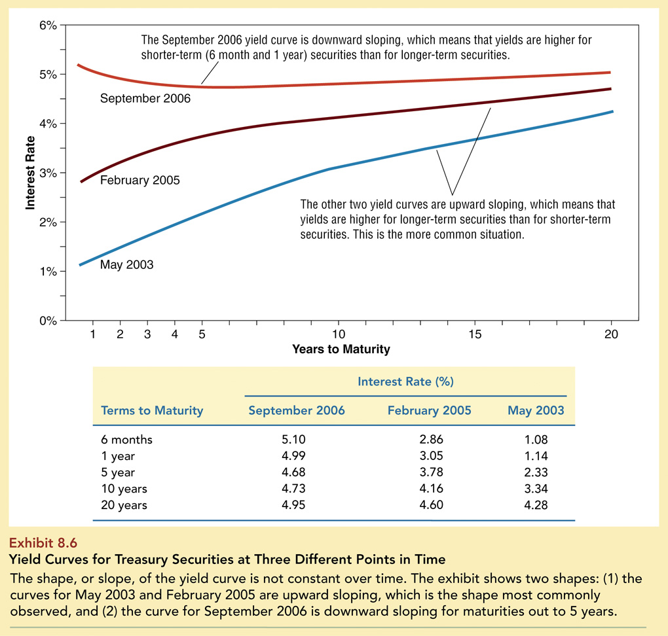
Exhibit 8.6: Yield Curves for Treasury Securities

Slide 65
The Structure of Interest Rates
The Cumulative Effect
In a period of economic expansion, both the real rate of interest and the inflation premium increase monotonically over time.
In a period of contraction, both the real rate of interest and the inflation premium decrease monotonically over time.

